Slide 1


Java Build Tools
IVAYLO KOLEV
April, 2019

Slide 2
Who am I?
Old Software Developer
Total pain of 11 years
Ivaylo_kolev@epam.com
Notes:
P37 – divide into 2 slides

Slide 3
AGENDA
1
Building a project by without a build tool
2
Dependency management
3
Maven Build
4
Gradle Build

Slide 4
Building a project by without a build tool
Download all jars that you need
Compile your source code – with a compilation classpath
Execute your tests – with a test classpath
Package your project - with a runtime classpath
Release your project
Notes:
P37 – divide into 2 slides

Slide 5
DEMO

Slide 6
What is a dependency
Dependencies are uniquely identified by a GAV
G – group id. Usually identifies the owner and the base package
A – artifact if. Identifies the name of the library
V – version. Uniquely identifies the the release of the artifact
They consists of:
.jar file - packaged and compiled source
Metadata file – describing the dependencies of the dependency
Their dependencies are not bundled inside the .jar file
The dependencies of the dependency are called transitive dependencies
If you are to use a library you need all its transitive dependencies
org.projectlombok:lombok:1.18.6
lombok-1.18.6.jar
Metadata file
Notes:
P37 – divide into 2 slides

Slide 7
Dependency Versioning
The most common versioning scheme is Semantic Versioning
When a new version is released and the increment is in:
Patch – a bug fix (backward compatible)
Minor – a new feature (backward compatible)
Major – backward incompatible changes (features or bugfixes)
1.18.6
Major
Minor
Patch
Notes:
P37 – divide into 2 slides

Slide 8
Example of a dependency
https://mvnrepository.com/artifact/com.google.http-client/google-http-client/1.29.0
Notes:
P37 – divide into 2 slides

Slide 9
Dependency scopes
Scopes show when a dependency is needed:
Compile – needed for compilation and runtime
Runtime – needed for runtime only
Test – needed for compilation and runtime of Test classes
Provided – needed for compilation but
Is not transitive
It will not be packaged (in the case of .war files)
Notes:
P37 – divide into 2 slides

Slide 10
Dependency download by a typical build tool
Public Repositories
1 – read declared project’s dependencies
2 – look up in local repository
3 – look up in company repository
Allows company to filter dependencies
Company libraries are published here (not in public repositories)
4 – look up in public repositories
5 – save in local repository
Developer’s machine
Company Repository
Project
Description
1
Build Tool
3
4
Local Repository
2
5
Always executed
Only if dependency is not in the repository
Notes:
P37 – divide into 2 slides

Slide 11
Maven
Started in 2001
Based on the concept of a project object model (POM)
XML description of the project
Relies on a convention over configuration
Project management and comprehension tool
Build process
Manages dependency management
Release
Deployment
Documentation
Notes:
P37 – divide into 2 slides

Slide 12
Maven – Project Object Model (pom.xml file)
<?xml version="1.0" encoding="UTF-8"?> <project> <modelVersion>4.0.0</modelVersion> <groupId>com.example</groupId> <artifactId>demo</artifactId> <version>0.0.1-SNAPSHOT</version> <dependencies> <dependency> <groupId>org.springframework.boot</groupId> <artifactId>spring-boot-starter-web</artifactId> </dependency> </dependencies> </project>
Notes:
P37 – divide into 2 slides

Slide 13
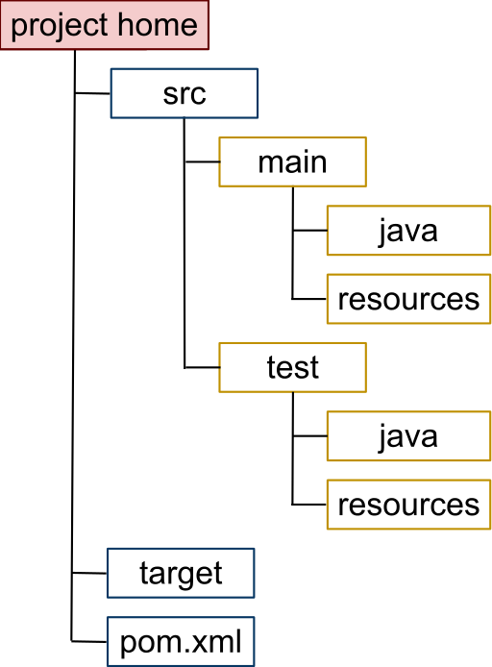
Maven – convention over configuration
Directory name | Description
project home | Contains the pom.xml and all subdirectories.
src/main/java | Contains the deliverable Java sourcecode for the project.
src/main/resources | Contains the deliverable resources for the project, such as property files.
src/test/java | Contains the testing Java sourcecode (JUnit or TestNG test cases, for example) for the project.
src/test/resources | Contains resources necessary for testing.
Notes:
P37 – divide into 2 slides

Slide 14
Maven – the build process
Maven has 3 build lifecycles
clean
default
site
Each lifecycle consists of phases
For some of the phases you could have intermediate phases. Which execute around a main phase.
pre, process, post
You can invoke any of the phases except for the intermediates
For each phase you have default plugin goals attached
Notes:
P37 – divide into 2 slides

Slide 15
Maven – clean lifecycle
Consists of only one phase: clean
This phase has 2 intermediate phases
Executed via: mvn clean
Phase | Type | Plugin Goal
pre-clean | Intermediate phase
clean | phase | clean:clean
post-clean | Intermediate phase
Notes:
P37 – divide into 2 slides

